Slide 1


DSCI 2710 ‒ Lecture 8 UNTBSTAT Lesson 6.5
Binomial Distribution
Slide Material from: Nottingham & Hawkes, Discovering Business Statistics

Slide 2
Objectives
Identify a distribution as binomial, Poisson, or hypergeometric.
Calculate probabilities using a binomial, Poisson, or hypergeometric distribution.

Slide 3
Properties of a Binomial Distribution
Properties of a Binomial Distribution
1. The experiment consists of a fixed number, n, of identical trials.
2. Each trial is independent of the others.
3. For each trial, there are only two possible outcomes. For counting purposes, one outcome is labeled a success, and the other a failure.
4. For every trial, the probability of getting a success is called p. The probability of getting a failure is then
1 − p.

Slide 4
Properties of a Binomial Distribution
Properties of a Binomial Distribution (cont.)
5. The binomial random variable, X, counts the number of successes in n trials.
6. For a binomial distribution, the mean is given by μ = np and the variance is given by σ² = np(1‒p).

Slide 5
Probability for a Binomial Distribution
Probability for a Binomial Distribution
For a binomial random variable X, the probability of obtaining x successes in n independent trials is given by
where x is the number of successes,
n is the number of trials, and
p is the probability of getting a success on any trial.

Slide 6
Example 5.5: Calculating a Binomial Probability Using the Formula
What is the probability of getting exactly six heads in ten coin tosses?
Solution
We showed earlier that coin tosses meet the criteria of the binomial distribution. For this problem, let X = the number of heads obtained out of ten coin tosses. There are ten coin tosses, so n = 10. We will say that a success is getting a head. We want the probability of exactly six successes, so x = 6. The probability of flipping a head in one coin toss is 0.5, which means that p = 0.5.

Slide 7
Example 5.5: Calculating a Binomial Probability Using the Formula (cont.)
Substituting these values into the binomial probability formula gives us the following.

Slide 8
Example 5.5: Calculating a Binomial Probability Using the Formula (cont.)
Thus, the probability of getting exactly six heads in ten coin tosses is approximately 0.2051.

Slide 9
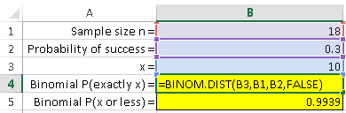
Finding a Binomial Probability Using Excel
Excel includes Binomial probability functions:
To compute the probability for exactly x successes after n trials, when the probability of success is p, use
=BINOM.DIST(x,n,p,FALSE)

Slide 10
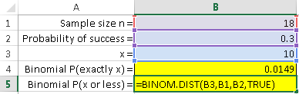
Finding a Binomial Probability Using Excel
To compute the probability for x successes or fewer, after n trials, when the probability of success is p, use
=BINOM.DIST(x,n,p,TRUE)

Slide 11
HLS UNTBSTAT Lesson 6.5

Slide 12
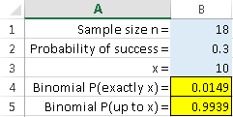

HLS UNTBSTAT Lesson 6.5: Example questions Use HLS6.5_BinomialProbability_worksheet file
A researcher wishes to conduct a study of the color preferences of new car buyers. Suppose that 30% of this population prefers the color brown. If 18 buyers are randomly selected, what is the probability that exactly 10 buyers would prefer brown? Round your answer to four decimal places.

Slide 13
APPENDIX: Using a TI-83/84 Plus calculator

Slide 14
Example 5.6: Calculating a Binomial Probability Using the Formula or a TI-83/84 Plus Calculator
A quality control expert at a large factory estimates that 10% of all batteries produced are defective. If he takes a random sample of fifteen batteries, what is the probability that exactly two are defective?
Solution
First, let’s verify that this process meets the criteria of a binomial distribution. Since the batteries are randomly sampled and, presumably, more batteries continue to be produced by the factory while the sampling takes place, we can consider the selection of the batteries to be identical, independent trials.

Slide 15
Example 5.6: Calculating a Binomial Probability Using the Formula or a TI-83/84 Plus Calculator (cont.)
Since we are testing fifteen batteries, the number of trials is n = 15. For each trial, there are two possible outcomes: either the battery is defective or it is not. We will consider a defective battery to be a success and 10% of all batteries produced are defective, so the probability of getting an individual success is p = 0.1. Let X = the number of defective batteries found in a sample of 15 batteries. We are looking for the probability that exactly two are defective, so we want the binomial probability, P(X = 2).

Slide 16
Example 5.6: Calculating a Binomial Probability Using the Formula or a TI-83/84 Plus Calculator (cont.)
Using the binomial probability formula for our solution would require us to calculate the following expression.
However, the TI-83/84 Plus calculator can calculate
P(X = x) directly using the following procedure.

Slide 17


Example 5.6: Calculating a Binomial Probability Using the Formula or a TI-83/84 Plus Calculator (cont.)
• Press and then to access the DISTR menu.
• Choose option A:binompdf(.
• Enter n, p, and x in the parentheses as: binompdf (n, p, x).
Thus, using a TI-83/84 Plus, we would calculate the probability as shown below and in the screenshot on the next slide.

Slide 18
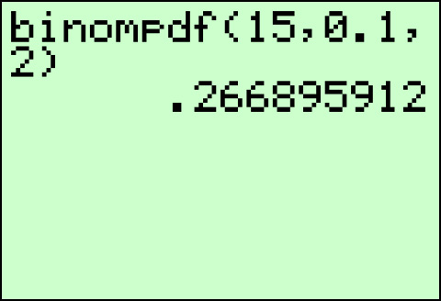
Example 5.6: Calculating a Binomial Probability Using the Formula or a TI-83/84 Plus Calculator (cont.)
Therefore, the probability that exactly two out of the fifteen batteries are defective is approximately 0.2669.

Slide 19
Example 5.7: Calculating Binomial Probabilities Using the Formula or a TI-83/84 Plus Calculator
A quality control expert at a large factory estimates that 10% of all the batteries produced at the factory are defective. If he takes a random sample of fifteen batteries, what is the probability that no more than two are defective?
Solution
This scenario is the same as in the previous example; therefore, we know that we have a binomial distribution with n = 15 and p = 0.1. This time we want the probability that no more than two are defective, which is

Slide 20
Example 5.7: Calculating Binomial Probabilities Using the Formula or a TI-83/84 Plus Calculator (cont.)
Thus we are looking for the probability that X = 0, or
X = 1, or X = 2. We can find by adding these three individual probabilities.
Using the binomial probability formula for our solution would require us to calculate the following expression.

Slide 21
Example 5.7: Calculating Binomial Probabilities Using the Formula or a TI-83/84 Plus Calculator (cont.)

Slide 22
Example 5.7: Calculating Binomial Probabilities Using the Formula or a TI-83/84 Plus Calculator (cont.)
A TI-83/84 Plus calculator can calculate P(X = x) directly as seen in the previous example. Thus, using a TI-83/84 Plus, we would calculate the probability as shown below and in the screenshot on the next slide.

Slide 23
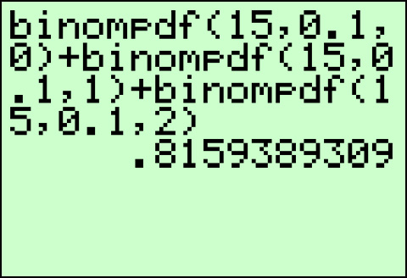
Example 5.7: Calculating Binomial Probabilities Using the Formula or a TI-83/84 Plus Calculator (cont.)
However, the TI-83/84 Plus calculator allows us to use an even more efficient method for this particular problem, as it will also directly calculate a cumulative probability,

Slide 24
Example 5.7: Calculating Binomial Probabilities Using the Formula or a TI-83/84 Plus Calculator (cont.)
• Press and then to access the DISTR menu.
• Choose option B:binomcdf(.
• Enter n, p, and x in the parentheses as: binomcdf (n, p, x).
So, using this more efficient method, we would calculate the probability as shown on the next slide.

Slide 25
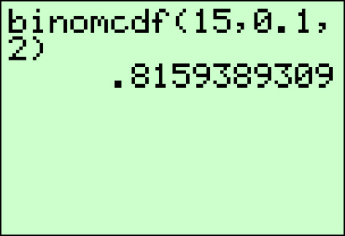
Example 5.7: Calculating Binomial Probabilities Using the Formula or a TI-83/84 Plus Calculator (cont.)

Slide 26
Example 5.7: Calculating Binomial Probabilities Using the Formula or a TI-83/84 Plus Calculator (cont.)
Therefore, the probability that no more than two out of the fifteen batteries are defective is approximately 0.8159.

Slide 27
Example 5.8: Calculating a Cumulative Binomial Probability Using a TI-83/84 Plus Calculator
What is the probability that a family with six children has more than two girls? Assume that the gender of one child is independent of the gender of any of the other children.
Solution
First, let’s verify that this scenario meets the criteria of a binomial distribution. We are told that the gender of each child is independent, so we can consider the births of the children to be identical, independent trials.

Slide 28
Example 5.8: Calculating a Cumulative Binomial Probability Using a TI-83/84 Plus Calculator (cont.)
The family has six children, so the number of trials is
n = 6. For each trial, there are two possible outcomes: the child is either a girl or a boy. Let’s define a success as having a girl. We can assume that both genders are equally likely; thus the probability of obtaining a success is p = 0.5. Let X = the number of girls out of the six children. We are considering the event of having more than two girls, X > 2. This is the complement to the event of having no more than two girls, X ≤ 2. Thus we can calculate the binomial probability by using the Complement Rule, as follows.

Slide 29
Example 5.8: Calculating a Cumulative Binomial Probability Using a TI-83/84 Plus Calculator (cont.)
Using the binomial formula for this problem would be cumbersome, so let’s use a TI-83/84 Plus calculator. We would enter the probability expression as shown on the next slide.

Slide 30
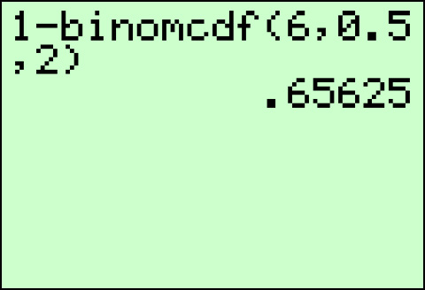
Example 5.8: Calculating a Cumulative Binomial Probability Using a TI-83/84 Plus Calculator (cont.)
Therefore, the probability that a family with six children has more than two girls is approximately 0.6563.

Slide 31
Example 5.9: Calculating a Cumulative Binomial Probability Using a TI-83/84 Plus Calculator
Suppose that 20% of the programs sold at the home games of a professional sports team during the course of one season contain a special discount coupon. If all eight friends in your group bought programs at one game, what is the probability that at least half of your friends received the discount coupon?

Slide 32
Example 5.9: Calculating a Cumulative Binomial Probability Using a TI-83/84 Plus Calculator (cont.)
Solution
Since there are a significant number of programs sold at the home games of a professional sports team throughout one season, and the number of trials we are considering is relatively small in comparison, we can model this situation as if the trials are independent. The reasoning is that the precise probabilities would not actually change enough to affect the value of the answer. We are considering eight programs; thus n = 8.

Slide 33
Example 5.9: Calculating a Cumulative Binomial Probability Using a TI-83/84 Plus Calculator (cont.)
If we define a success to be receiving a discount coupon, then the probability of obtaining a success is
p = 0.2. Let X = the number of discount coupons received in the eight programs bought by your friends. We are interested in the probability that at least half of the eight friends get a discount coupon, so at least four out of the eight, or As in the previous example, in order to use the cumulative binomial probability function on a TI-83/84 Plus calculator to solve this problem, we will need to use the Complement Rule.

Slide 34
Example 5.9: Calculating a Cumulative Binomial Probability Using a TI-83/84 Plus Calculator (cont.)
This is still not exactly what we need because the TI-83/84 Plus calculator can only calculate cumulative probabilities of the form Fortunately, this situation is not too difficult to deal with due to one of the characteristics of the binomial distribution. The value for x must be a whole number; therefore,

Slide 35
Example 5.9: Calculating a Cumulative Binomial Probability Using a TI-83/84 Plus Calculator (cont.)
Using all of this information and a TI-83/84 Plus calculator, we calculate the probability as shown below and in the screenshot on the next slide.

Slide 36
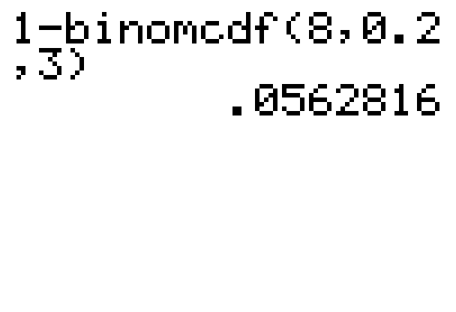
Example 5.9: Calculating a Cumulative Binomial Probability Using a TI-83/84 Plus Calculator (cont.)
Therefore, the probability that at least half of the eight friends find discount coupons in their programs is approximately 0.0563, which indicates that it is not very likely.

